Slide 1
Jermyn Borough Council Meeting
5/19/22

Slide 2
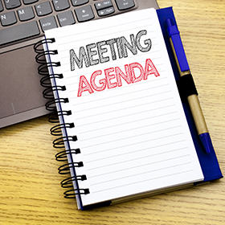
Meeting Agenda
May 19,2022
CALL TO ORDER
PLEDGE OF ALLEGIANCE
ROLL CALL
PREVIOUS MEETING MINUTES
TREASURER REPORT/BILLS PAYABLE
CORRESPONDENCE
PUBLIC COMMENT
PROFESSIONAL REPORTS
POLICE
FIRE
EMA
SOLICITOR
CODE ENFORCEMENT
ZONING
ENGINEER
TAX COLLECTOR
MAYOR
COMMITTEE REPORTS
BRIDGE STREET PARKING UPDATE (SAFETY)
COMCAST
PLAYGROUND INSURNACE REQUIREMENTS
COAL MINER CORNER COMMITTEE
CIVIL SERVICE BOARD
NEW BUSINESS

Slide 3
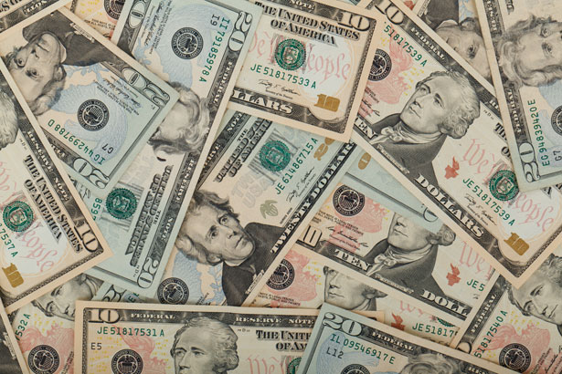
Treasurer’s report
5/19/22
ASSETS
Checking/Savings
Capital Reserve - DPW 10,726.47
Capital Reserve - Police 4,681.82
Crime Watch Fund 222.69
General Fund - Community 322,990.36
General Fund - FNB 4,732.62
Holiday Lights Fund 1,374.09

Slide 4
Treasurer’s report
Investment - General Fund 1,001.72
Investment - Liquid Fuels 33,820.62
Investment - Paving Fund 1,012.11
Investment - Recycling 5,004..39
Investment - Refuse 2,600.72
Liquid Fuels - FNB 56,303.25
Petty Cash 231.00
Recreations Fund 19,381.24
Recycling - Community 10,063.44
Refuse Checking - FNB 121,552.11
Total Checking/Savings 595,698.65

Slide 5
Treasurer’s report
200000 · Accounts Payable 21,038.38
Long Term Debt 327,580.78

